Slide 1

Intelligent Interview
Scheduling System
Proposed Enhancements for SOT 2026
Submitter: Lynn Zhang
Date:2025/09/29

Slide 2

Core Pain Points of SOT 2025
Based on field research , pain points identified:
Candidate-Side Issues
Organizer-Side Challenges
Employer Challenges
Information Black Box: No knowledge of interviewer identities
Labor-Intensive: Extra manpower for order maintenance
Extra Burden: Staff needed for queue management
Unpredictable Wait Time: Average 2 hours standing
Monitoring Blind Spots: No real-time booth awareness
Information Asymmetry: Can't adjust allocation dynamically
Physical Strain: Affects interview performance
Lack of Data: No quantitative metrics available
Data Gaps: No detailed post-event performance data
Opportunity Risk: Fear of missing key positions
Core Conflict: Traditional Physical Queuing vs. Modern Efficient Recruitment Needs

Slide 3

Success Metrics - Quantifiable Goals for 2026
Problem-oriented success indicators designed to measure meaningful improvements across all stakeholder groups.
50%
4.2/5
95%
Wait Time Reduction
Satisfaction Score
Interview Guarantee
From 120 minutes to 60 minutes average effective wait time
Improved from 2.8/5 with zero standing time
Students secure at least 1 interview with target company
50%
85%
99%
Staff Reduction
Match Accuracy
System Uptime
On-site staff reduced to under 10 people
Job-candidate match rate increased from 50%
Handles 500+ concurrent users reliably

Slide 4


Solution Design - Core Technology Innovations
Smart Queueing Algorithm System delivering four breakthrough innovations for intelligent queue management.
01
02
Multi-Level Priority Management
Dynamic Smart Insertion
High-Priority Mechanism → Smart Insertion → Conflict Resolution → Real-Time Sync architecture ensures fairness while preventing abuse through limited priority credits.
Algorithm calculates dynamic threshold = avg interview time + buffer. Triggers insertion suggestions when priority wait exceeds normal wait by threshold amount.
03
04
Auto Conflict Resolution Engine
Virtual Queuing + Real-Time Sync
Three-tier priority system (High 3pts > Inserted 2pts > Normal 1pt) with up to 7 rounds of auto adjustment ensuring convergence with graceful degradation.
WebSocket + Redis + DB persistence tech stack eliminates physical queuing, supports resting while waiting with distributed locks for concurrency safety.

Slide 5


Business Case - Value & Impact Analysis
Multi-stakeholder value creation demonstrating significant benefits and sustainable implementation across all user groups.
For Students
For Organizers
For Employers
Maximized Time Value: From passive 2-hr wait to active 60-min planning
Cost Savings: 50% less manpower needed
Zero Overhead: No guidance staff needed
Better Management: Data-driven operations
Better Matching: Intelligent candidate-job pairing
Improved Experience: Wait in rest area vs. standing for hours
Reusability: One system supports multiple events
Time Control: Clear queue visibility
Real-time Control: Complete visibility and monitoring
Data Accumulation: Complete event analytics
Information Transparency: Know interviewers in advance
Guaranteed Opportunities: At least 1 key interview assured
Sustainability Advantage: Moderate tech barrier with low maintenance cost, reusable across different events, and strong commercialization potential.

Slide 6

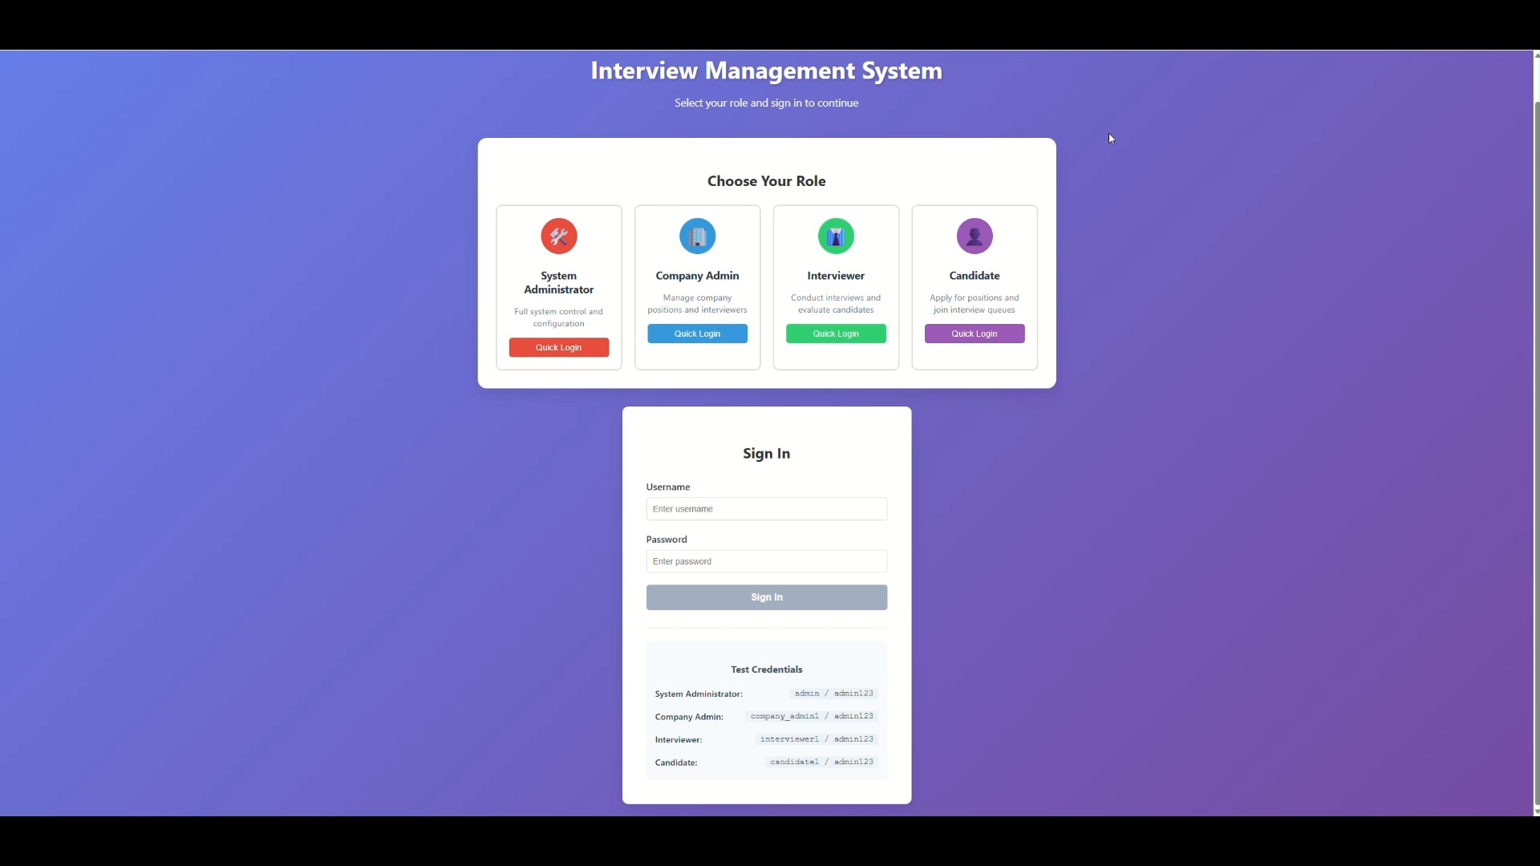
Demo / Prototype Showcase
Smart Queue Assistant
Interviewer Queue Manager
Organizer Monitoring Console
Student app interface providing real-time queue status, interviewer information, and intelligent scheduling recommendations.
Interviewer dashboard interface with candidate profiles, queue visibility, and scheduling control for optimal interview flow.
Live event control screen with comprehensive analytics, real-time monitoring, and system management capabilities.
Algorithm Visualization
Concurrency Test
Data Visualization
Live view of insertion and conflict resolution processes in action
Stable performance under 100 simultaneous users with real-time updates
Complete event lifecycle analytics and comprehensive reporting system

Slide 7







Project Value & Learning Outcomes
Comprehensive achievements demonstrating technical innovation, engineering excellence, and systematic problem-solving approach.
Algorithm Innovation
Engineering Skills
Problem-Solving Mindset
Custom multi-level queueing algorithm for complex scheduling
Full-stack experience: needs → design → code → test → deploy
Grounded in real-world pain points, solved systematically
Dynamic threshold design balancing fairness & efficiency
High-concurrency system design with data consistency
MVP design under resource constraints
Data-driven validation and feedback loops
"Smart Insertion" systematized into algorithmic decisions
Professional-grade architecture and implementation
Project Differentiators
Originality: Based on real research with custom algorithm design
Practicality: Solves visible problem with clear use case
Technical Depth: Covers algorithms, concurrency, architecture
End-to-End: Full-stack implementation from frontend to deployment

